Slide 1

Ger’s Garage
Guided Technology project
Willyan Aleksander de Paula Machado

Slide 2
Overview
Ger’s Garage and its demand
Web-project with restful backend to book services

Slide 3
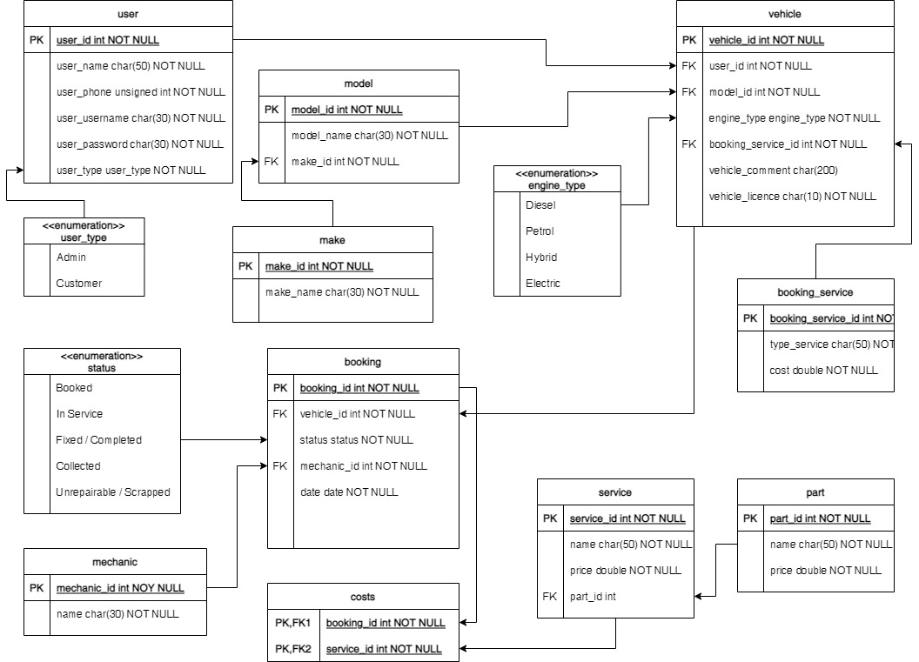
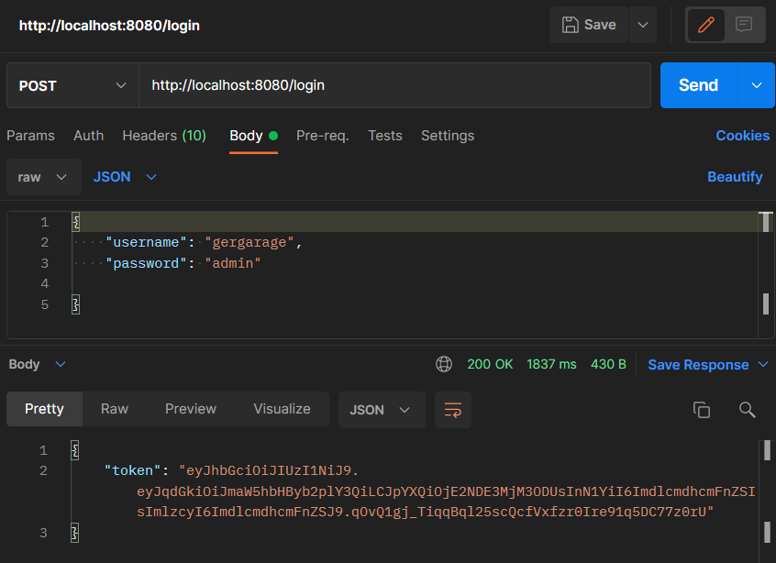
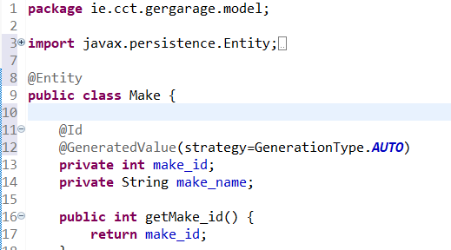
Progress
Database
Login/Backend

Slide 4
Next steps:
Keep going with the backend
Stick to the frontend development
Write the following report chapters

